Slide 1
Recurrent Neural Networks for Cognitive Neuroscience

Slide 2
What are recurrent neural networks?

Slide 3
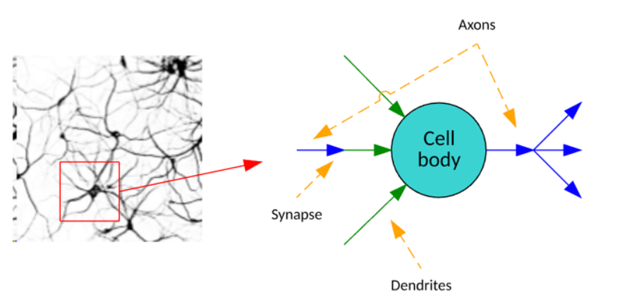
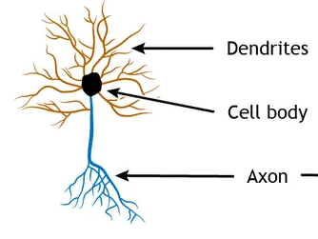
Biological inspiration
Input
Node
Output
Notes:
Neural networks represent an information-processing paradigm that is loosely inspired by the human brain. In the brain, neurons are highly connected and communicate chemical signals through synapses between axons and dendrites. The human brain is estimated to have 100 billion neurons, with each neuron connected to up to 10,000 other neurons.

Slide 4
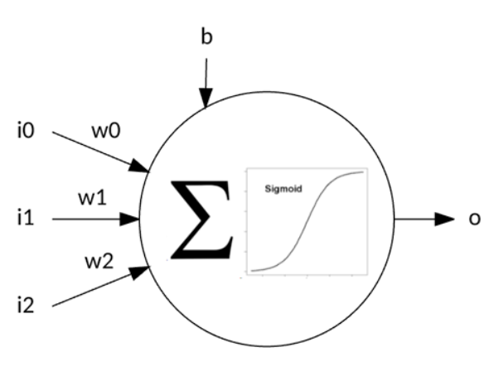
Artificial neuron
Inputs
Output
Node
Notes:
Artificial neural networks communicate signals (numbers) through weights and activation functions (such as sigmoids) that activate neurons. Using a training algorithm, these networks adjust those weights to solve a given problem. The following image illustrates a single perceptron that has three inputs: a weight for each input, an input bias, and an output. The output is calculated from the summation of the input and weight products, including the bias pass through an activation function. I explore the lowly perceptron as a first example before venturing further into back-propagation.

Slide 5
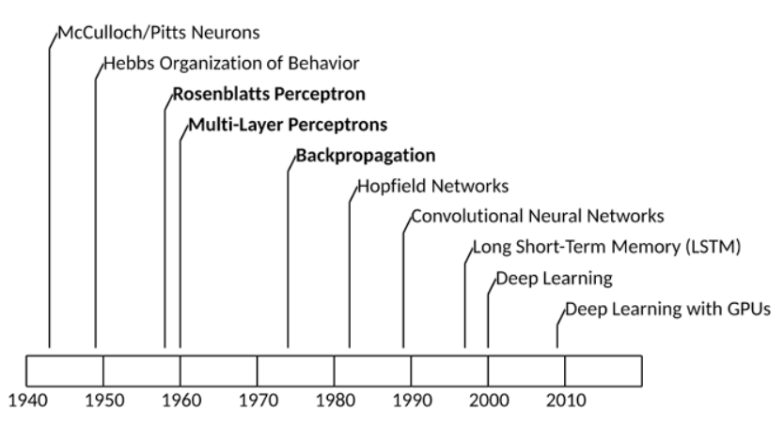
A history of neural networks
Feed-forward networks
Recurrent networks
Transformers …

Slide 6
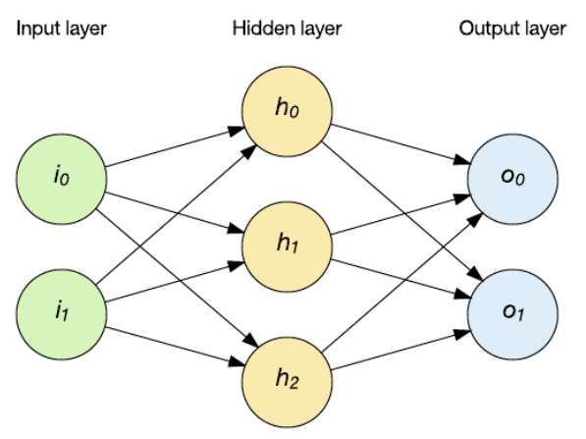
Feed-forward neural networks
Feed-forward layer
Input layer
Output layer
Input vector reaches the network through the hidden layers, and results in an output
Notes:
the input maps to the output (every time the input is applied) in a deterministic way

Slide 7
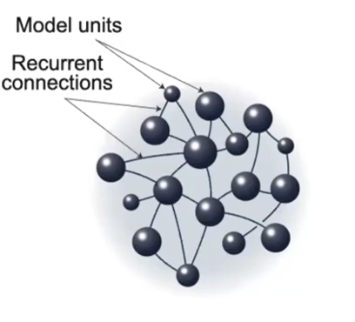
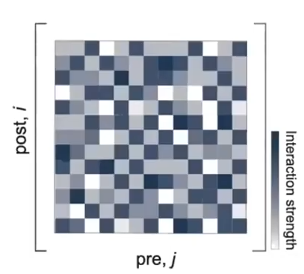
Recurrent neural networks
Recurrent layer
Connection Matrix
Input layer
Output layer

Slide 8
How can artificial neural networks help us understand the brain?

Slide 9
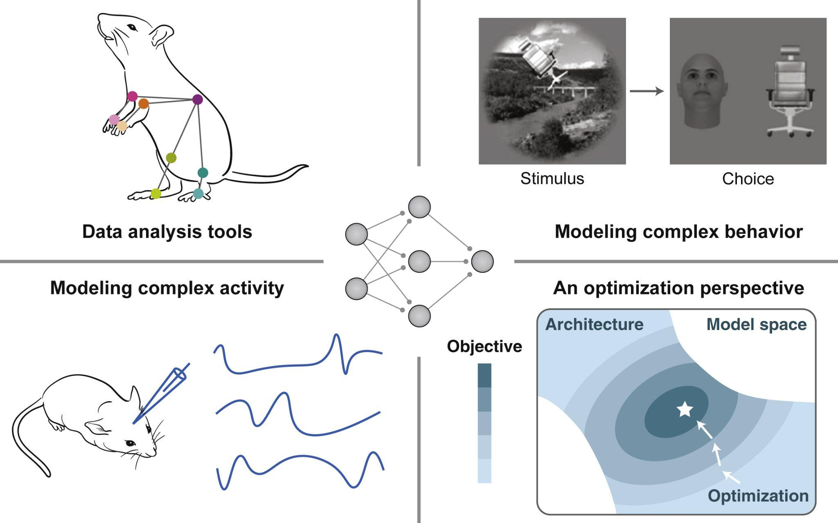
Yang & Wang, Neuron 2020

Slide 10
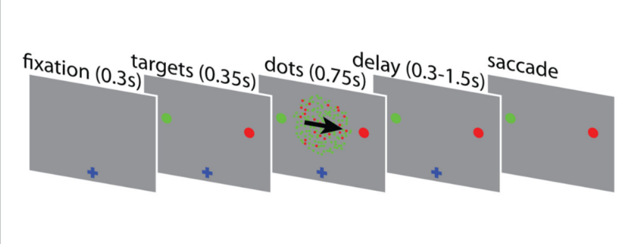
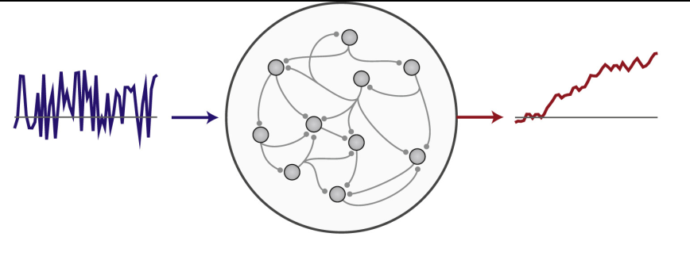
RNN 101
1. Cognitive task as a learning problem
2. RNN is trained on the task
Input
Output
3. Reverse engineering the trained network to gain a mechanistic understanding of how the model solves the task

Slide 11
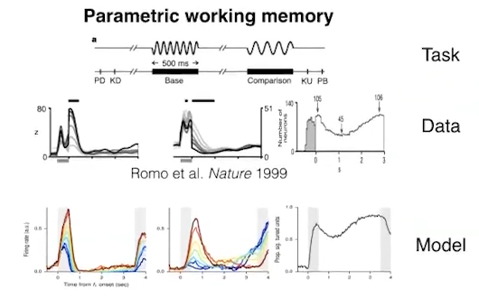
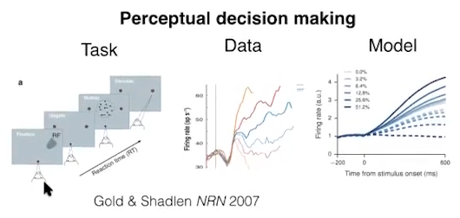
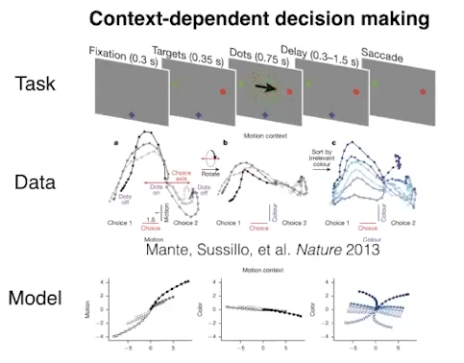
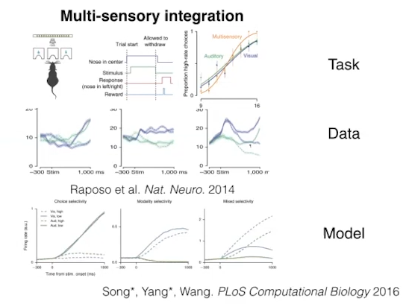

Slide 12
How do you train a RNN on a task?

Slide 13
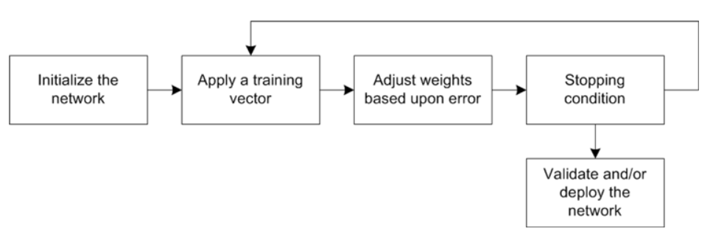
Training artificial neural networks
Notes:
Perceptron learning follows this general flow. I initialize the weights of my network to a random set of values. I then iterate over my training set until I see no further errors. Applying a training vector means applying a training vector to the network and executing the network (feeding that training vector forward to yield an output value). I subtract this output from the desired output (called the error). I use this error, with a small learning rate, to adjust the weight based on the contribution of the input. In other words, the weight is adjusted by the error multiplied by the input (associated with the given weight) multiplied by a small learning rate. This process continues until no more errors occur.

Slide 14
Recurrent layer
Backpropagation
Input layer
Output layer
1. Error
Difference between predicted output and actual output
2. Error is sent back to each neuron in backward direction
3. Compute gradients of errors with respect to the weights

Slide 15
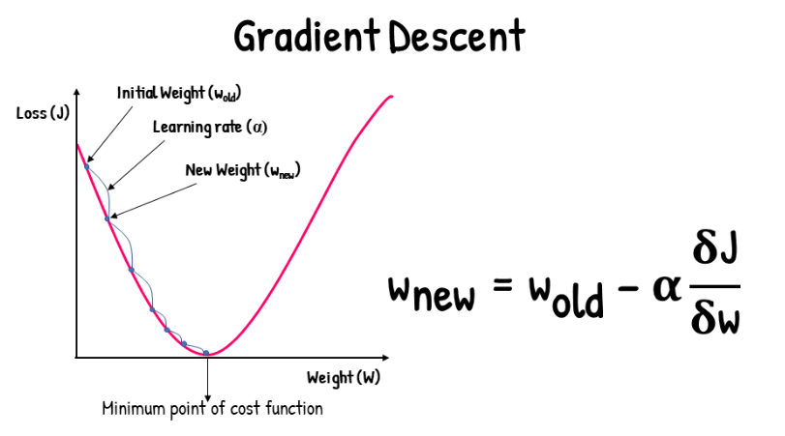
Updating the weights: Gradient descent

Slide 16
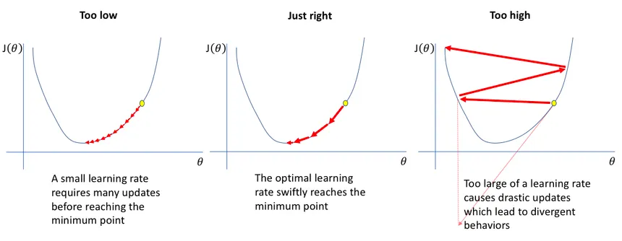
Adjusting the learning rate

Slide 17
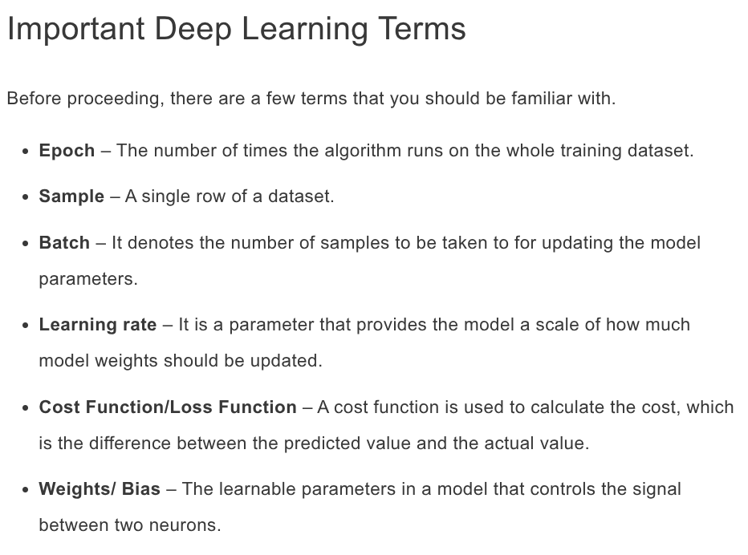

Slide 18





Deep learning libraries

Slide 19
How to train a network with PyTorch?

Slide 20
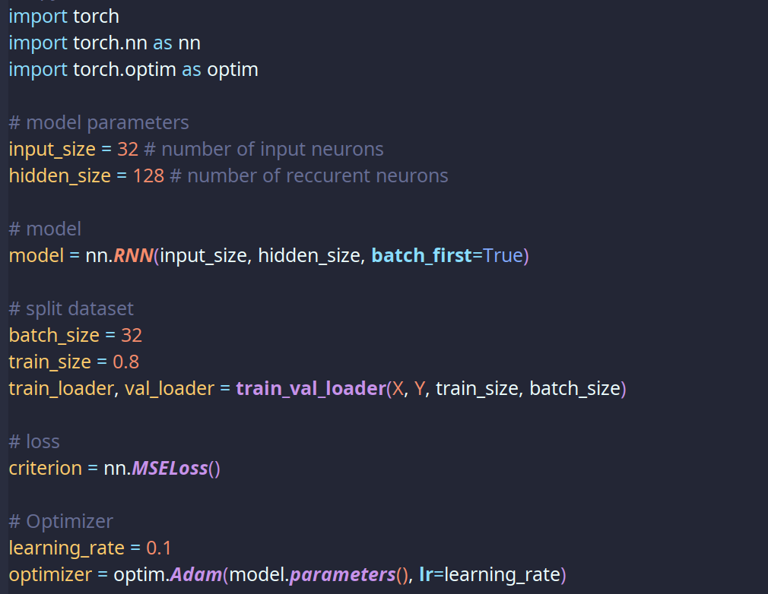

Slide 21
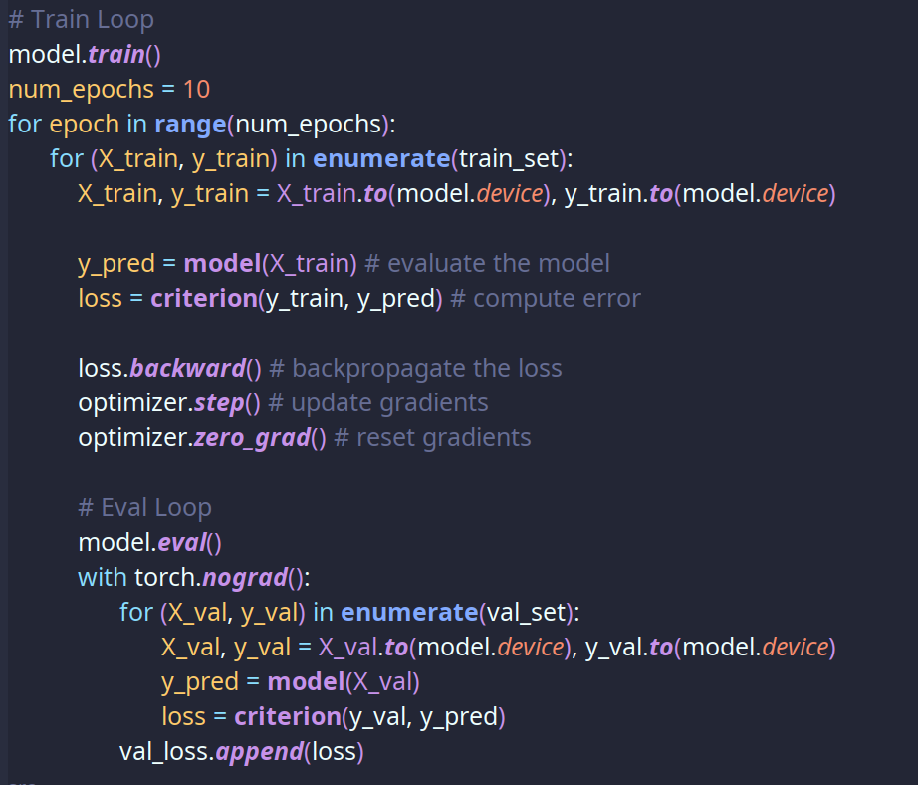

Slide 22
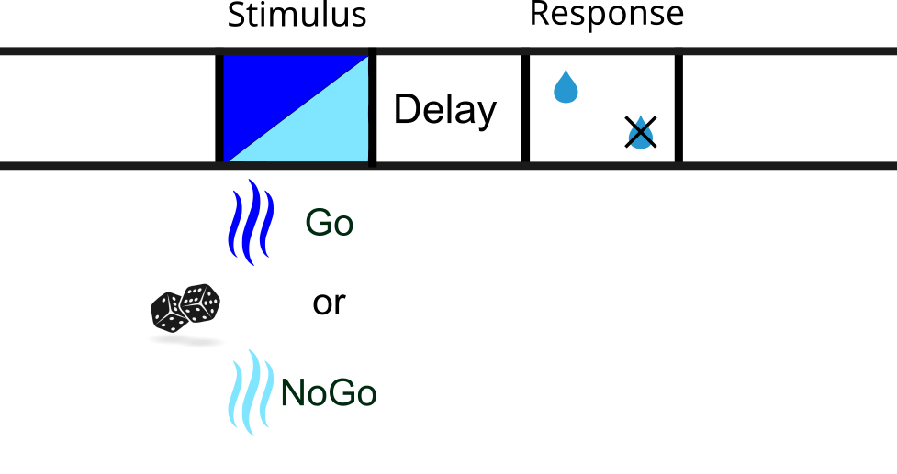
A Delayed Go/NoGo task

Slide 23
Practical Example: Mante et al. 2013

Slide 24
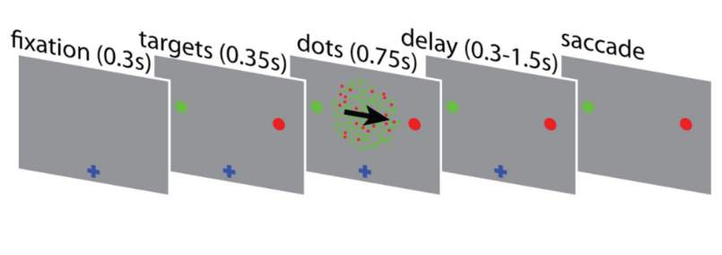
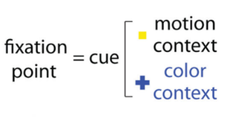
Learning problem: Context dependent decision making task
Mante et al., Nature 2013

Slide 29
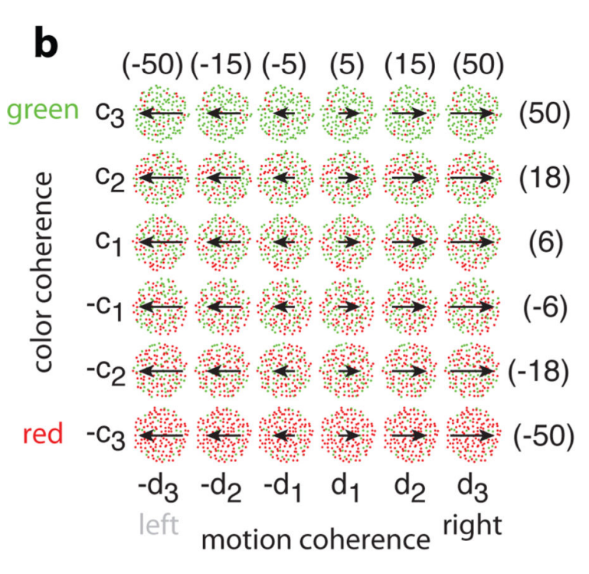
Stimulus set

Slide 30
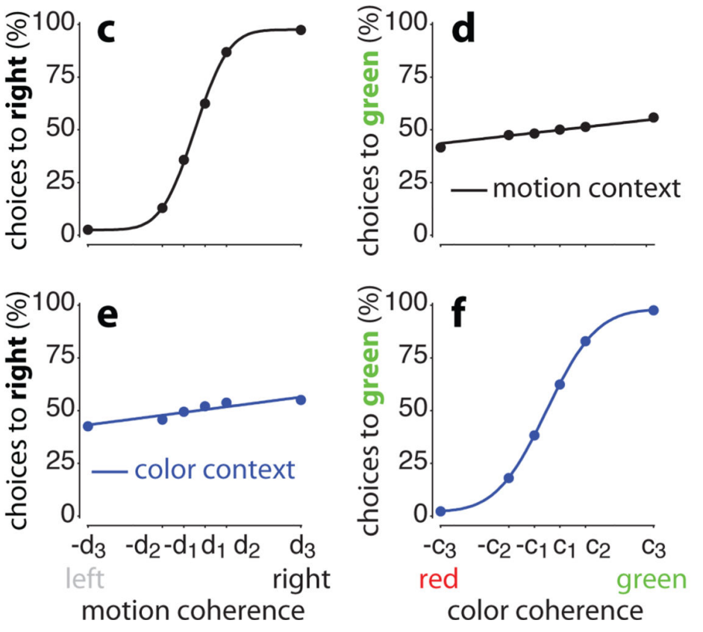
Performance

Slide 31
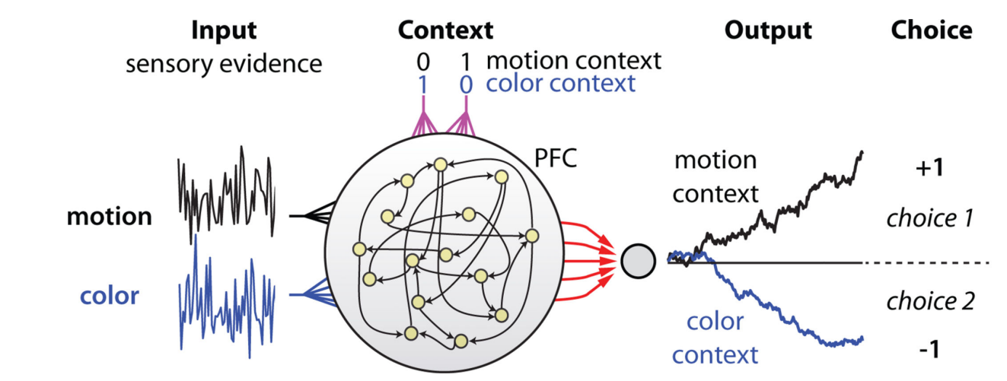
A neural network model of input selection and integration
Task + RNN + Reverse Engineering -> Mechanistic model of cognition

Slide 32
Let’s model a simpler task

Slide 33
A random dot motion task
Intput
Output

